Slide 1

NYC Taxi
By Hao Guo, Jiaozhe Zhang, Wentao Lu

Slide 2
Dateset:
The 4 Taxi Trips tables contain a total of 28 million Green Taxi trips in New York City from 2017 to 2020. Each record represents one trip, with fields containing details about the pick-up/drop-off times and locations, distances, fares, passengers, and more.
The Taxi Zones table contains information about 265 zone locations in New York City, including the location id, borough, and service zone.
The Taxi Zones Map files contain a map of New York City with divisions for the 265 locations.

Slide 3
Goals:
We want to investigate the following 5 questions related to the dataset.
What is the average number of trips per week?
What is the average distance traveled per tip?
Which days of the week and times of the day will be busiest?
What will likely be the most popular pick-up and drop-off locations?
Which factors that have the greatest impact on fare.

Slide 4
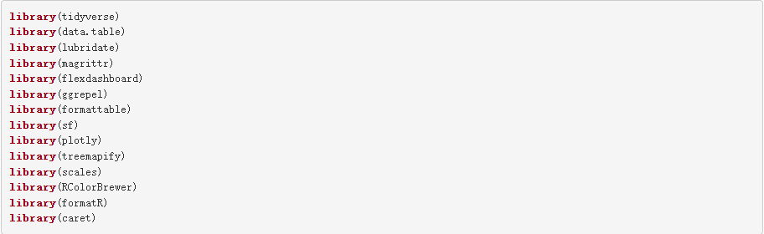
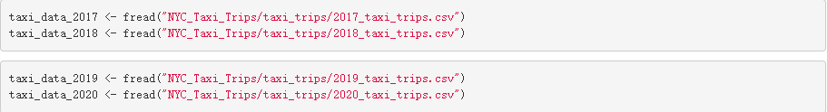
library(data.table) - helps load data faster than read csv.
Loading all of the dataset into Rstudio

Slide 5
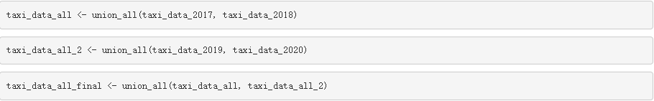
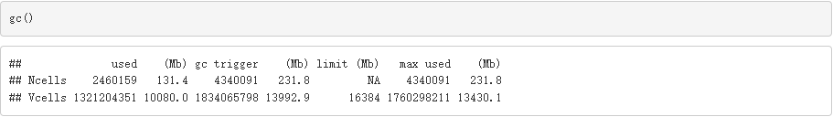
At first I tried to union all the 4 dataframes which took too long. I decided to conduct two separate union_all statements to fix the issue.
Garbage collection function to print memory usage statistics.

Slide 6
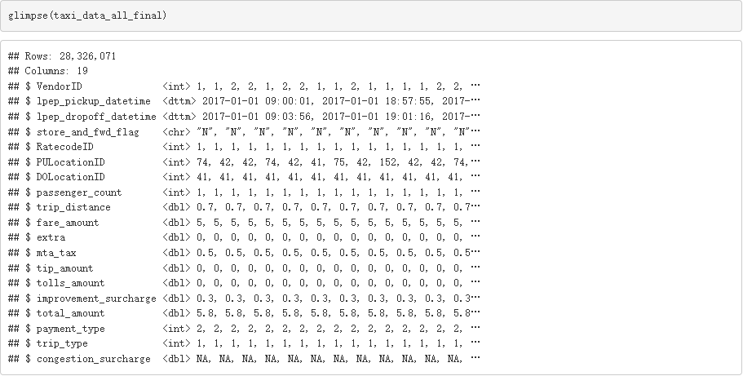
Removed previous dataframes to save GB in Global Environment and view data types.

Slide 7
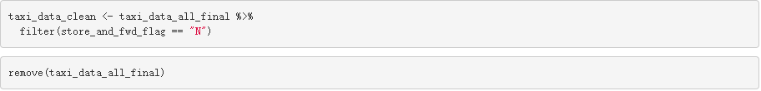
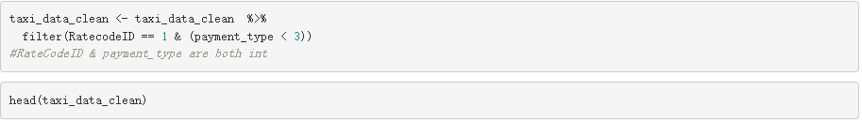
Cleaning steps:
1. Remove trips that were NOT sent via “store and forward”.
2. Only keep street-hailed trips paid by card or cash with a standard rate.
3. Remove any trips before 2017 or after 2020.

Slide 8

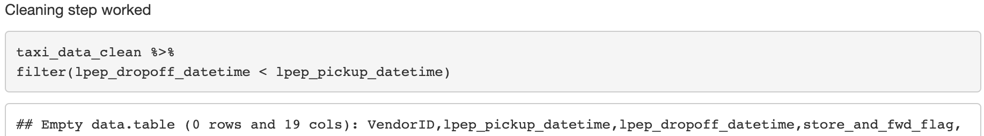
Cleaning steps:
4. Any trips with no recorded passengers had 1 passenger.
(Verify it worked)
5. If pickup date/time is AFTER drop-off date/time, swap them.

Slide 9
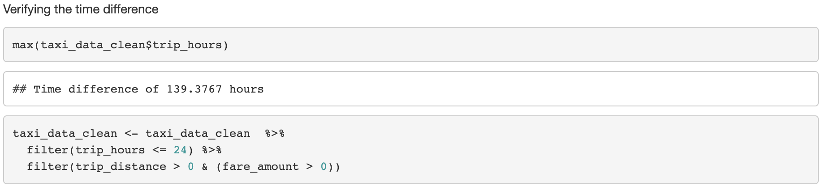
Cleaning steps:
6. Remove any trips lasting longer than a day, and any trips which show a distance and fare amount of zero.

Slide 10
Cleaning steps:
Removing columns that are not required for analysis.
Another way to remove a column by name.
Importing the next dataframe.
Joining the new dataframe by pickup location ID.
Joining the new dataframe by drop off location ID.

Slide 11
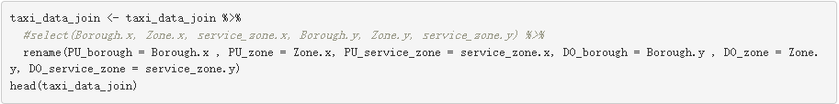
Cleaning steps:
Renaming columns.
Removed previous dataframes to save GB in Global Environment and Returning Weekday, Day of Week and Day of month.
Extracting year from date/time column and month name.

Slide 12
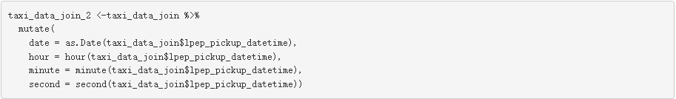
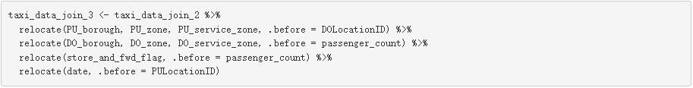
Cleaning steps:
Extracting date/time.
Removing more columns.
Relocating the join result.
Saving the final clean copy of data to use in separate r markdown. One for analyzing and one for visualizing.

Slide 13
With the work we have done, we can calculate：
Avg Fare
$12.32
Avg Distance
2.87 Miles
Avg Duration
35 Minutes

Slide 14
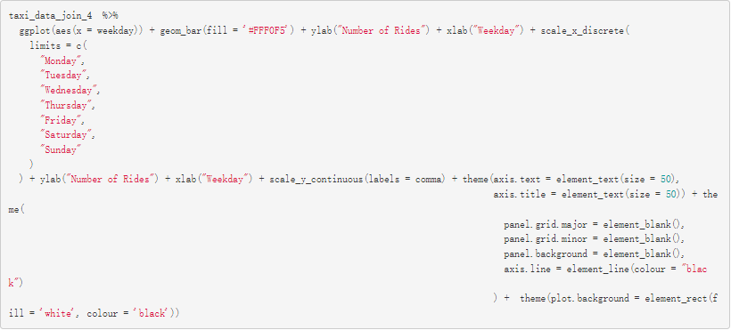
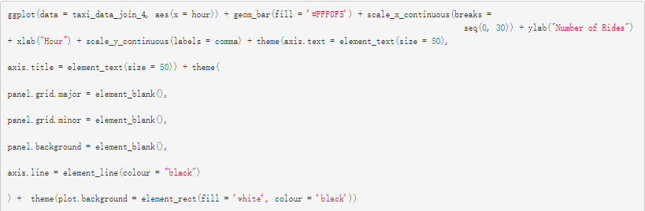
We can also find the Busiest Days and Busiest Times.

Slide 15
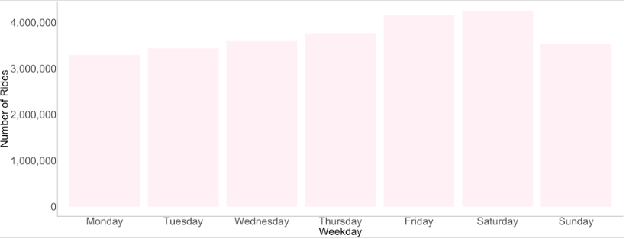
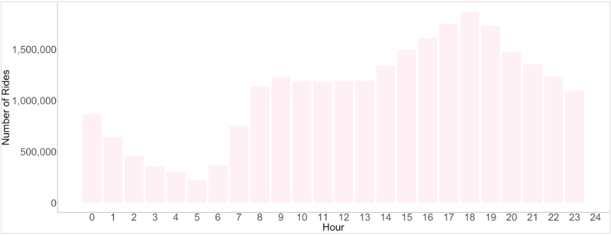
The Busiest Days and Busiest Times.

Slide 16
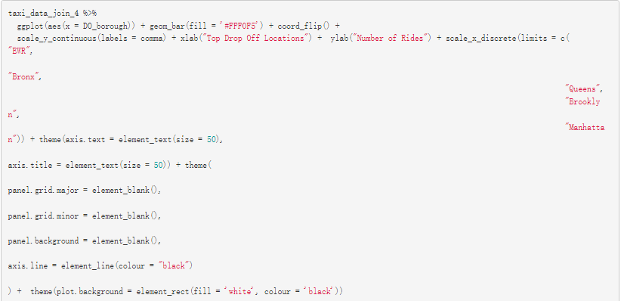
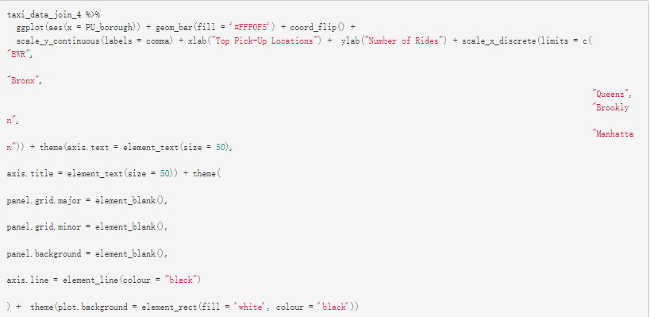
We can find the Most popular pick-up locations and Most popular drop-off locations as well.

Slide 17
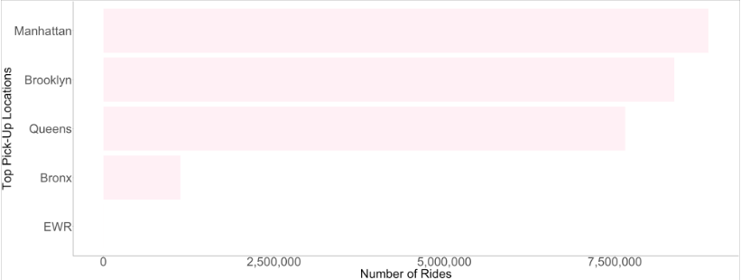
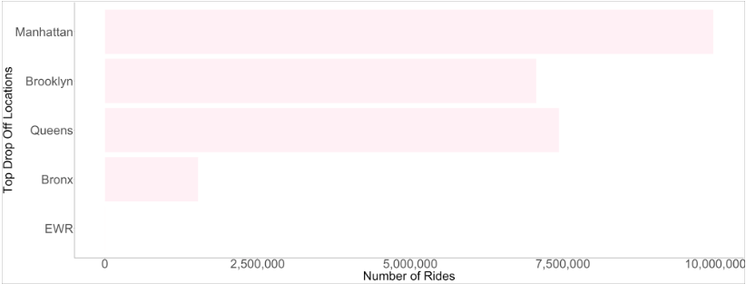
Obviously, Manhattan is the Most popular pick-up locations and Most popular drop-off locations
so boring!

Slide 18
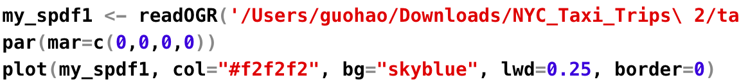

Map：

Slide 19
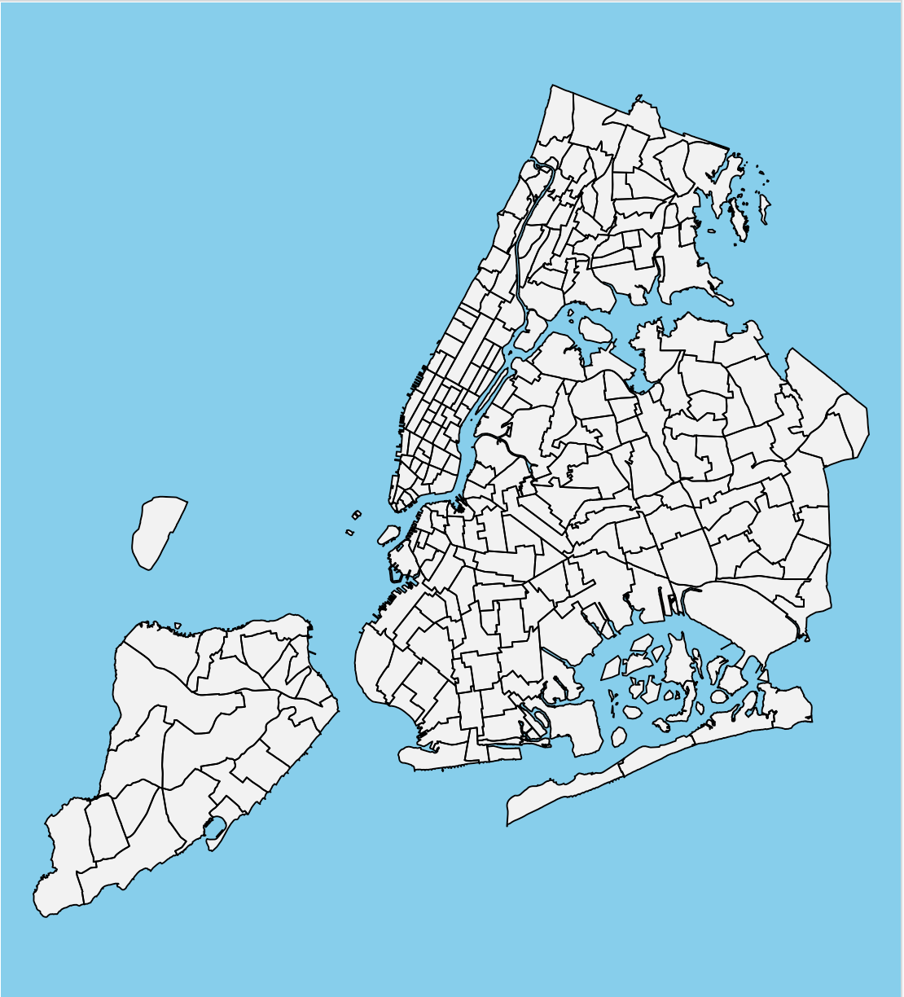
Map：

Slide 20
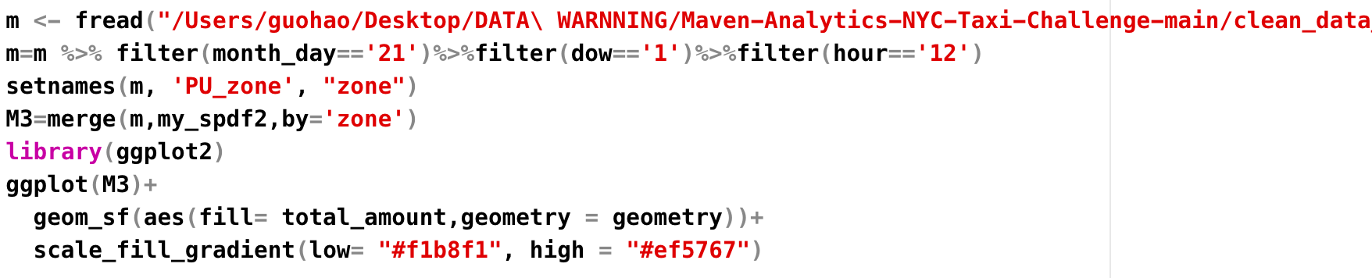
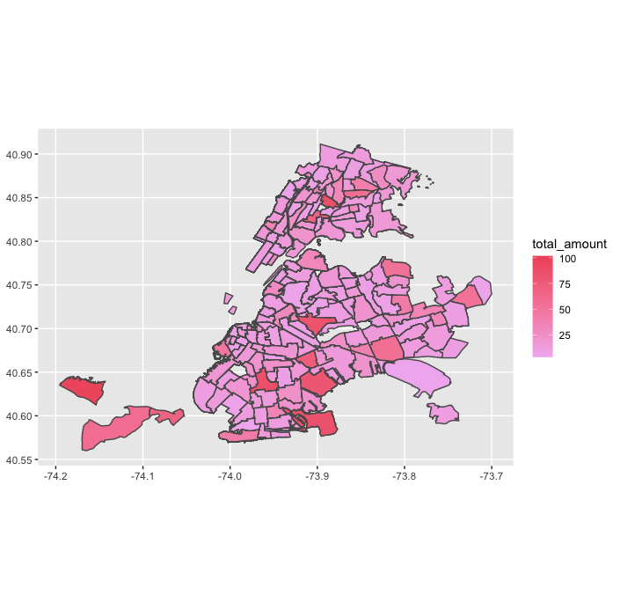
Map：

Slide 21
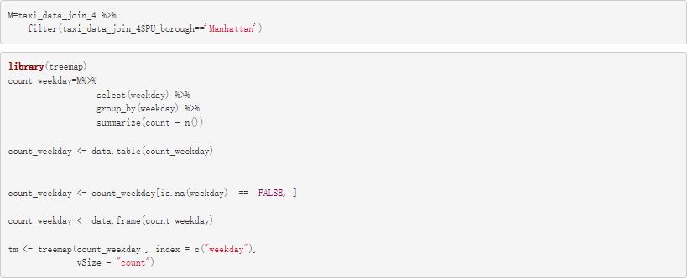
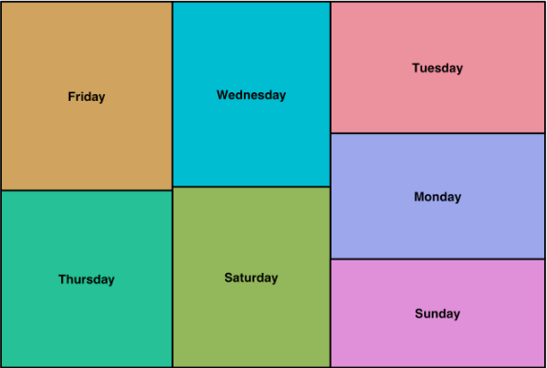
Zoom in Manhattan.

Slide 22
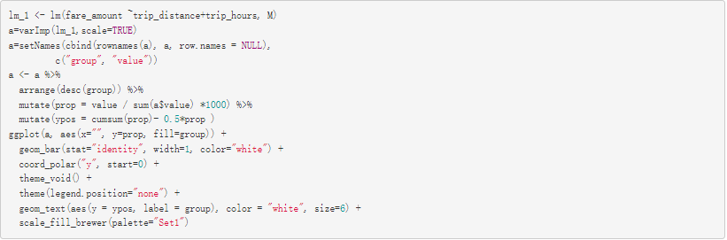
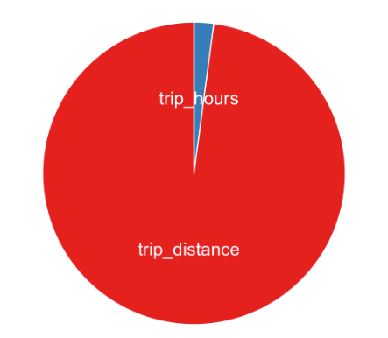
Finally we did a simple analysis
which factors have the greatest impact on fare.
Reasonable！

